Slide 1
Executive Summary
Key Points
Airlines have recovered quickly after major accidents
Airline industry revenue growth has been steady regardless of accidents
Airline industry usage growth has been steady regardless of accidents
Accidents occur less often for airlines than driving, mile for mile
Fatalities occur less often for airlines than driving, mile for mile
Airline travel imposes much less mortality risk than other uncommon causes of death

Slide 2
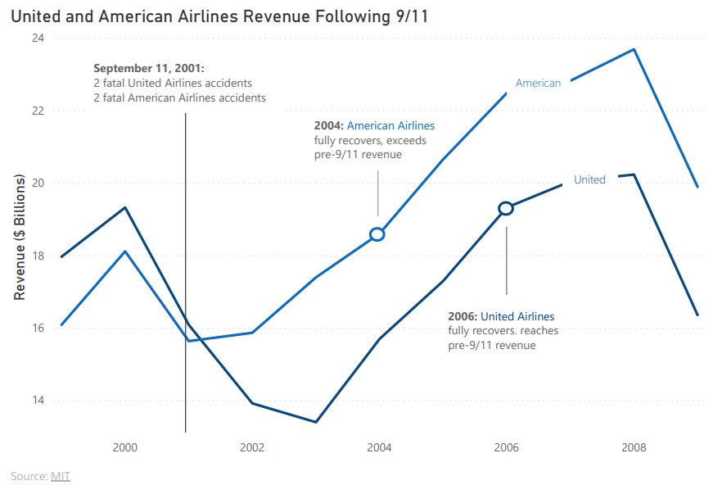
Specific Airlines Recover Quickly From Major Accidents
Notes:
Have your chosen design methodology (colors, labels, chart types, etc.) defended/justified.
Blue is my main default color for all charts, but these two lines are series for different airlines, so I show that with color. I reinforce the color mapping with the color of the text of the airline name along with the airline name being a part of the line. I label three main points on the chart, September 11, and then the points for each airline where they recover revenue-wise. Seeing the trend of revenue after 9/11 is the main focus of the chart, not the particular revenue amount, so I decided not to include written out value labels on the lines. A line chart here was the best option simply because I am focusing on trend over time and am not focused on the specific values of each year.

Slide 3
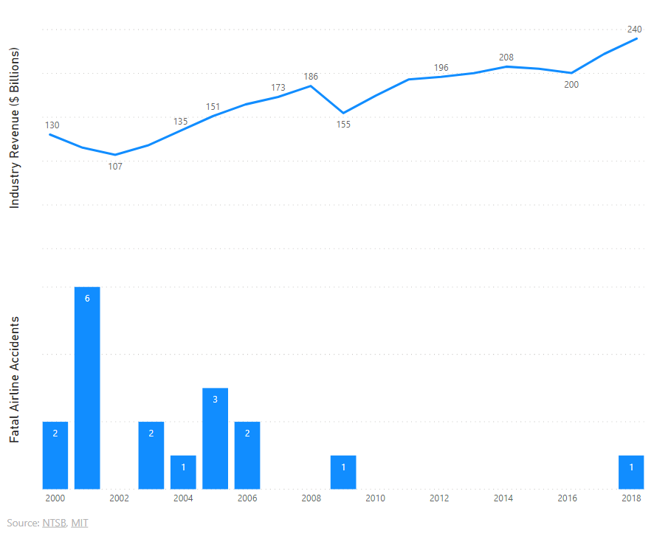
Airline Revenue Growth Has Been Steady Regardless of Fatal Accidents
Notes:
Have your chosen design methodology (colors, labels, chart types, etc.) defended/justified.
For this chart (and the next one) I wanted to show how key market indicators were affected by fatal airline accidents. Instead of doing a second y-axis, I chose to put the two charts on top of each other with the different y-axes labeled. Since the values are displayed on the bars and the lines, and the units are given by the axis title, I decided labeling y-axis ticks would be redundant. As for color, I chose the default theme blue color for the data which does not indicate anything other than being related to airline data. Finally, the Industry revenue was displayed on top since that is the focus of the key point.

Slide 4
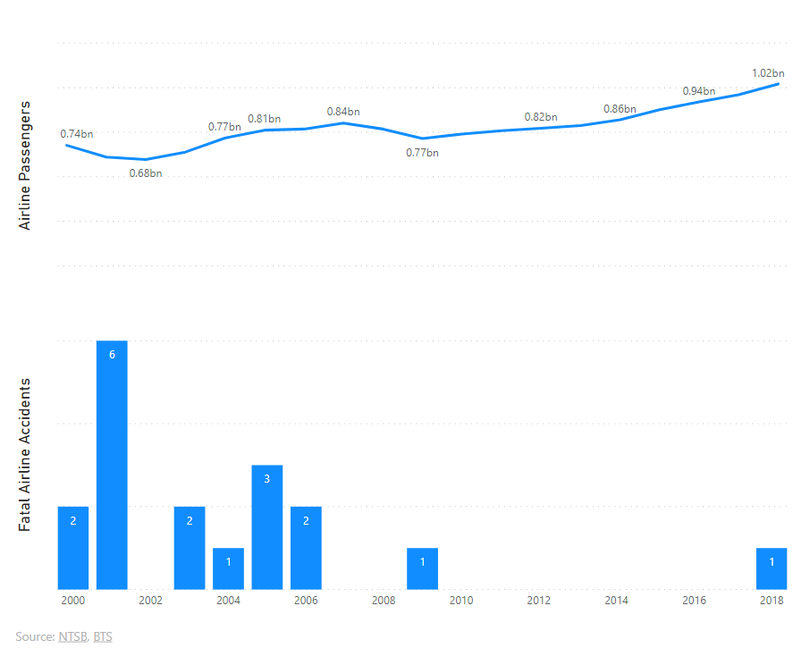
Airline Usage Has Continued to Grow After Fatal Accidents
Notes:
Have your chosen design methodology (colors, labels, chart types, etc.) defended/justified.
This chart used the same methodology and justifications as the last chart. The bottom chart is actually the same exact chat as slide three, it’s just a different top chart.

Slide 5
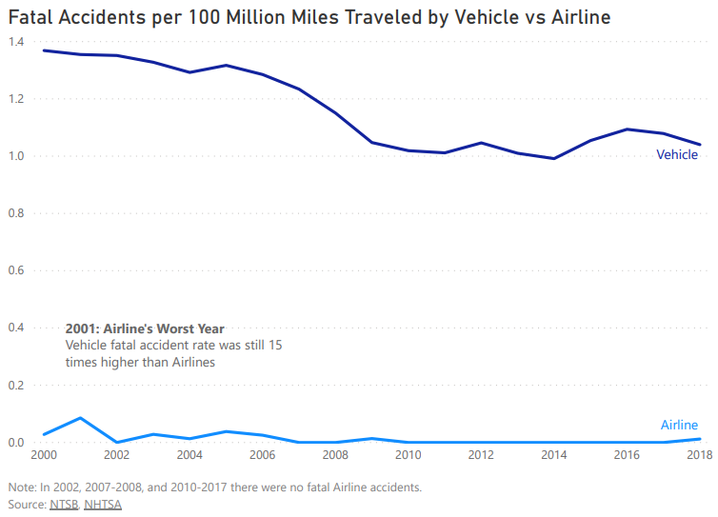
Airline Accidents Are Less Frequent Than Driving
Notes:
Have your chosen design methodology (colors, labels, chart types, etc.) defended/justified.
Since the default blue color had been displaying airline data before, I chose to again use that color for the airline series. I used a different blue color to represent the vehicle series to stick with the theme. I was debating using a column chart to compare the two values of the two series year by year, but decided that the gap between the two lines put emphasis on the point that there were many more vehicle fatal accidents than airline fatal accidents per 100 million miles traveled. I specifically call out the airline’s worst year, 2001, to emphasize my point about the rate being so much smaller than vehicles. I also decided not to label either axis since the x-axis is obvious and the y-axis is called out in the title. Finally, both in this chart and the next chart, I add a note to confirm that there were no fatal accidents in the years where the line seems to be on the x-axis.
This chart and the next chart were two of my most convincing ways to show flying is safer than driving and combines data from two different sources. People will argue that they drive much more than they fly so of course they’d be more likely to die in a car accident. This statistic gives the two values the same denominator so they can be compared in the same terms.

Slide 6
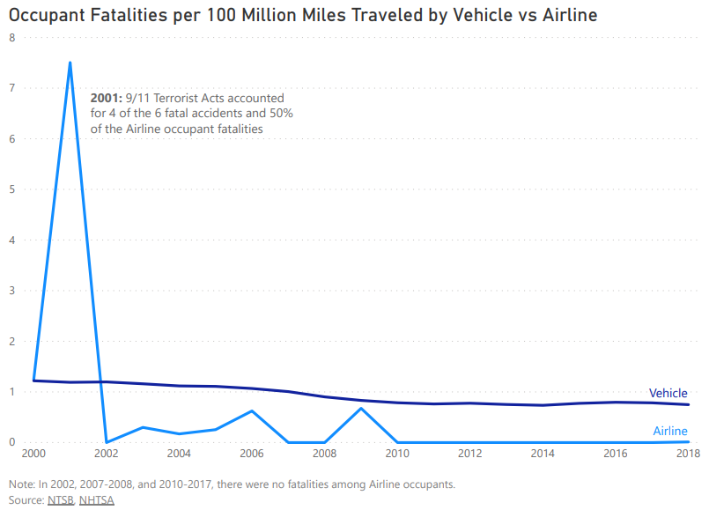
Airline Fatalities Are Less Frequent Than Driving
Notes:
Have your chosen design methodology (colors, labels, chart types, etc.) defended/justified.
This chart uses the same justifications as the previous chart.

Slide 7
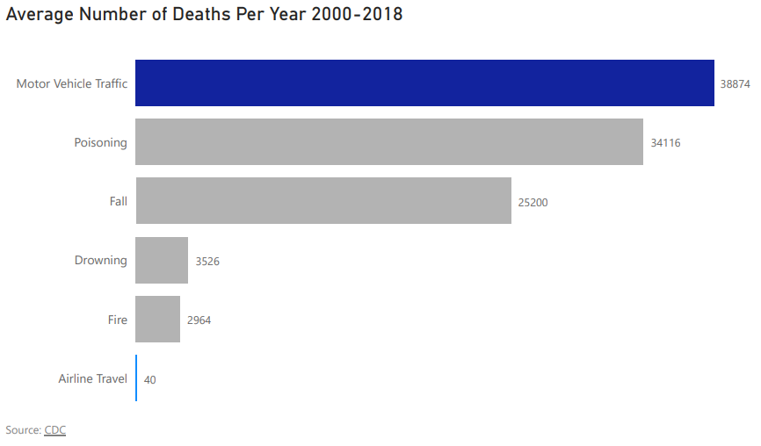
To Put Airline Travel Risk in Perspective
Notes:
Have your chosen design methodology (colors, labels, chart types, etc.) defended/justified
For this last chart, since I was using a specific blue for the vehicles and airline series in the previous charts, I kept those the same. I then use a neutral grey for the unrelated causes of death. I add data value labels to this chart to help the audience understand the magnitude of the differences a little more, especially since the airline travel bar is so short. I use a bar chart here since my categories are longer text and I didn’t want them to be horizontal or rotates with a column chart.

